Slide 1
Identify slow learners for remedial teaching and capacity building for innovative methods
CSE7301 University Project
Viva Voice
Batch Number: CEI-22
STUDENT NAME | Roll No
MEDA SAI SANTOSH | 20211CEI0112
SHAIK MOHAMMED SAIF | 20211CEI0117
VALIPIREDDY VENKATA SAINATH REDDY | 20211CEI0119
PULLALACHERUVU MAHITHA | 20211CEI0120
Under the Supervision of,
Dr. Joe Arun Raja
Professor
School of Computer Science and Engineering
Presidency University
Name of the Program: B.Tech Computer Engineering [AI & ML]
Name of the HoD: Dr. Gopal Krishna Shyam
Name of the Program Project Coordinator: Dr. P Sudha
Name of the School Project Coordinators: Dr. Sampath A K / Dr. Abdul Khadar A / Mr. Md Ziaur Rahman

Slide 2
Introduction
In the modern educational landscape, addressing the needs of diverse learners—particularly slow learners—has become increasingly important. These students often struggle to keep pace with traditional classroom instruction due to factors such as cognitive delays, low motivation, anxiety, limited attention span, and foundational knowledge gaps. Although they possess the capacity to learn, the uniform nature of conventional teaching methods does not cater to their specific needs, leading to disengagement, poor academic performance, and even dropout in severe cases. Recognizing this issue, our project proposes a technology-driven solution that leverages artificial intelligence to identify slow learners early and provide them with personalized remedial strategies tailored to their individual learning styles.
This project lies at the intersection of Educational Technology and Artificial Intelligence. It uses machine learning to analyze academic performance and detect slow learners. Natural language processing is applied to interpret behavioral traits like motivation and attention. The system aims to deliver early intervention, inclusive support, and improved learning outcomes.

Slide 3
Literature Review
The reviewed literature highlights diverse approaches to supporting slow learners through educational interventions and technology integration. Tamur, Juandi, and Agustian conducted a meta-analysis on Realistic Mathematics Education (RME) in Indonesian junior high schools, emphasizing the value of individualized learning, structured group activities, ethnomathematical contexts, and repeated exposure to concepts for effective comprehension. Al-Harthy and Jat explored the cognitive and emotional needs of slow learners, advocating for early identification, personalized learning environments, inclusive teaching practices, and collaboration among educators and parents. S. V. V. S. and R. T. introduced a technology-based model using quiz-based classification and 3D interactive tools to identify slow learners and provide tailored support through dashboards, chatbots, and peer forums. Chandler-Hayward detailed the use of AI-powered systems in higher education to revamp learning for slow learners, employing real-time analytics, personalized content, and interactive chatbots to ensure responsive teaching. Collectively, these studies underscore the growing potential of combining pedagogical strategies with AI technologies to enhance learning outcomes for slow learners.
However, existing systems often fall short in key areas. Many lack integration of both behavioral and academic data, limiting their ability to form a holistic view of a student’s needs. There is also a notable absence of real-time feedback mechanisms and adaptive learning paths in most local educational settings. These gaps highlight the necessity for innovative platforms that not only identify slow learners more effectively but also offer timely, tailored interventions. Our project addresses these shortcomings by combining AI, behavioral analysis, and educational design to create a responsive and personalized learning environment that supports every student’s unique journey.

Slide 4
Existing method Drawback
Previous studies indicate that slow learners often go unnoticed due to the lack of data-driven monitoring in conventional classrooms. Remedial teaching has traditionally relied on the teacher’s judgment, with limited personalization. With the rise of AI and machine learning, there is a growing trend of leveraging digital tools to identify learning difficulties early and suggest personalized interventions.
Teacher-based Observation Drawback: Teachers rely on their own judgment to identify slow learners, which can be inaccurate or missed due to class size and time constraints.
Standard Remedial Teaching Drawback: Remedial teaching often lacks personalization, and not all students receive the tailored support they need to progress effectively.
AI-based Learning Platforms (e.g., Khan Academy, BYJU’s) Drawback: These platforms focus mostly on academic performance (test scores) and do not consider behavioral aspects like motivation, anxiety, or attention levels.
Traditional Classroom Models Drawback: There is no real-time monitoring of students’ progress, making it harder to address learning challenges when they occur, leading to delayed interventions.
Lack of Integrated Data Drawback: Existing tools often separate academic data from behavioral data, limiting a comprehensive understanding of each student’s learning needs.

Slide 5
Proposed Method
The proposed Identify slow learners for remedial teaching and capacity building for innovative methods will utilize Academic Performance Filtering to recommend electives based on student preferences and historical data. The system will:
Objective: Identify students who consistently perform below average across multiple subjects or have a history of failing grades.
Method: Use test scores, assignments, quizzes, and exams to establish a baseline of performance. Students with consistently low scores can be flagged for intervention.
Thresholds: Define performance thresholds to categorize students as "at risk" (e.g., scores below 45% on three consecutive assignments).

Slide 6
Objectives
1 Create Student Profiles
Goal: Collect academic, behavioral, and emotional data to build comprehensive student profiles.
Details: Gather test scores, class participation, emotional states like stress, and behavior patterns to understand learning challenges and emotional barriers.
2 Develop Personalized Learning Paths
Goal: Tailor learning to each student's needs and learning style.
Details: Analyze student data to create customized learning paths, adjusting content and pace to the student's strengths and preferences.
3 Provide Timely Learning Interventions
Goal: Offer real-time support based on student progress and challenges.
Details: AI monitors student performance, adjusting lessons or offering emotional support as needed (e.g., remedial lessons, motivational prompts).
4 Continuous Monitoring and Feedback
Goal: Track student progress and provide feedback in real-time.
Details: Students receive instant feedback on assignments, while teachers get data to adjust teaching strategies as needed.

Slide 7
Methodology/Modules
1: Comprehensive Learning Assessment
Academic Performance Analysis – Collects and evaluates test scores and grades.
Learning Style Detection – Identifies preferred learning styles (visual, auditory, kinesthetic).
Behavioral Tracking – Monitors motivation, attention, participation.
Module 2: AI-Powered Remedial Strategies
Personalized Learning Plans – Customized learning paths for each student.
Conceptual Gap Identification – Finds weak concepts needing more practice.
Targeted Practice Generation – AI generates specific exercises for improvement.
Module 3: Teacher Dashboard & Analytics
Performance Overview – Visual dashboard showing class-wide and individual progress.
At-Risk Detection – Alerts for students needing urgent support.
Progress Monitoring – Tracks improvement over time with charts.
Strategy Evaluation – Measures which teaching interventions are most effective.
Module 4: Innovative Teaching Methods
Style-Based Teaching Recommendations – Suggests techniques suited to each learning style.
Multi-Sensory Support Tools – Includes visual aids, hands-on materials, and audio resources.
Engagement Tools – Gamification, group tasks, and motivational prompts.

Slide 8
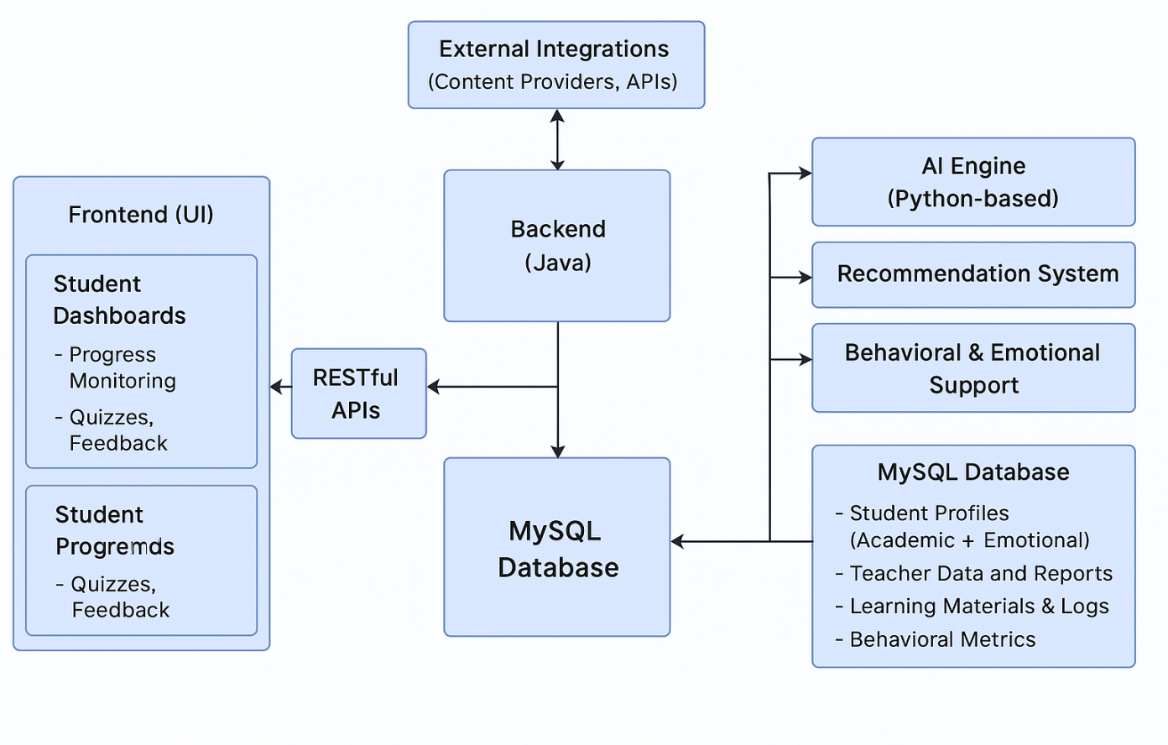
Architecture

Slide 9
Hardware/software components
Hardware Requirements:
Processor: Intel i5 or higher
RAM: 8GB or more
Storage: 500GB HDD or SSD
Software Requirements:
Operating System: Windows 10 or Linux
Languages: Python (for the Machine Learning algorithms),Java, ReactJs(for the frontend)
Libraries: Scikit-learn, Flask (web framework), MySQL connector
Database: MySQL
IDE: PyCharm or Visual Studio Code

Slide 10
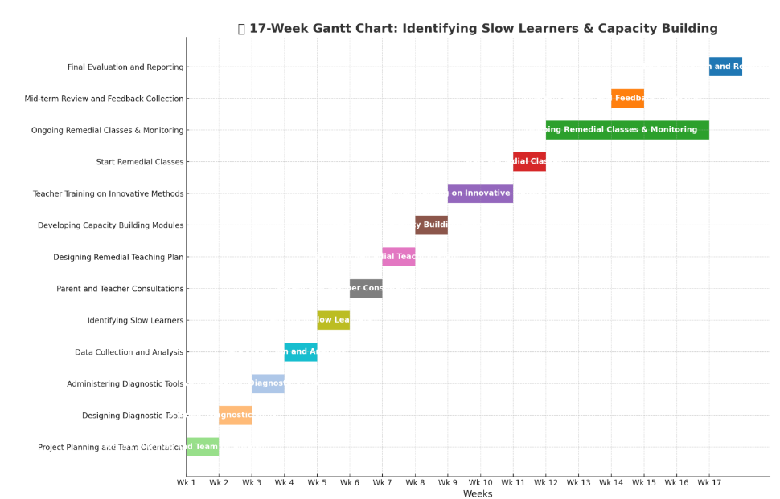
Timeline of Project

Slide 11
Expected Outcomes
1. Improved Academic Performance
Significant gains in test scores and deeper understanding of core concepts.
Reduced mistakes in previously difficult areas through targeted support.
2. Adaptive & Engaging Content Delivery
Students retained more information using preferred formats (visual, audio, interactive).
Increased engagement and mastery through multi-modal learning.
3. Emotional & Behavioral Support
Lowered anxiety and stress through timely AI interventions.
Improved focus and emotional resilience during learning.
4. Teacher Insights & Interventions
Real-time analytics enabled proactive support for struggling students.
Teachers personalized strategies based on student-specific data.
5. Increased Student Autonomy
Students set goals, tracked progress, and took charge of their learning journey.
Boosted motivation and self-confidence through feedback and ownership

Slide 12
Conclusion
The implementation of the personalized learning system has proven highly effective in supporting slow learners by offering tailored educational content and real-time analytics. This approach significantly improved academic performance by allowing students to progress at their own pace, ensuring better comprehension and mastery of foundational concepts. Equally important, the system addressed emotional and behavioral challenges by providing timely support, reducing anxiety, and increasing motivation. Teachers benefited from data-driven insights that enabled timely and targeted interventions, enhancing collaboration and improving student outcomes. The system also empowered students to take ownership of their learning through goal-setting and self-monitoring, fostering confidence and independence. Its scalable and efficient design made it adaptable to various educational settings while easing teachers' administrative workload. Looking ahead, integrating advanced AI features such as natural language processing and virtual mentors will further enhance personalization and emotional support, making this system a transformative tool for inclusive, adaptive education.

Slide 13
Github Link
The Github link provided should have public access permission.
Github Link
https://github.com/Sainath9666

Slide 14
References
[1] M. Tamur, D. J. Juandi, and A. G. Agustian, "Realistic Mathematics Education in Indonesia and Recommendations for Future Implementation: A Meta-Analysis Study," Journal of Physics: Conference Series, vol. 1460, no. 1, pp. 012017, 2020.
[2] A. A. Q. Al-Harthy and Z. G. Jat, "Early Identification and Intervention: Amplifying the Voice of Slow Learners," SSRN Electronic Journal, 2023.
[3] S. V. V. S. and R. T., "Identifying Slow Learners Using Quiz-Based Classification and 3D Interactive Models," PhilArchive, 2023.
[4] M. Chandler-Hayward, "Data-Driven Decision Making in Higher Education: One University's Process of Revamping the Superintendent Licensure Program," Journal of Education and Learning (EduLearn), vol. 14, no. 4, pp. 123–135, 2023.
[5] Arnellis, A., Fauzan, A., Arnawa, I. M., & Yerizon, Y. (2020). The Effect of Realistic Mathematics Education Approach Oriented Higher Order Thinking Skills to Achievements’ Calculus. Journal of Physics: Conference Series, 1554(1), 012033. https://doi.org/10.1088/1742-6596/1554/1/012033.

Slide 15
References
[6] Ashari, N. W., & Salwah. (2021). Bringing Real Analysis Subject Into Real Life: an Experimental Research for Prospective Teacher of Mathematics Study Program Using Realistic Mathematics Education. Journal of Physics: Conference Series, 1752(1), 012010.https://doi.org/10.1088/1742- 6596/1752/1/012010
[7] S. Karande and M. Kulkarni, "Poor School Performance," Indian J. Pediatr., vol. 72, no. 11, pp. 961–967, 2005.
[8] J. Lerner, Learning Disabilities: Theories, Diagnosis, and Teaching Strategies, 9th ed. Boston, MA, USA: Houghton Mifflin, 2003.
[9]M. Zhu and K. VanLehn, "Improving Learning with AI-Powered Feedback Systems: A Review," Computers & Education, vol. 165, Art. no. 104137, 2021.
[10] A. S. Aljohani and M. Davis, "Learning analytics in higher education: A systematic literature review," Computers & Education, vol. 124, pp. 98–111, Oct. 2018..

Slide 16
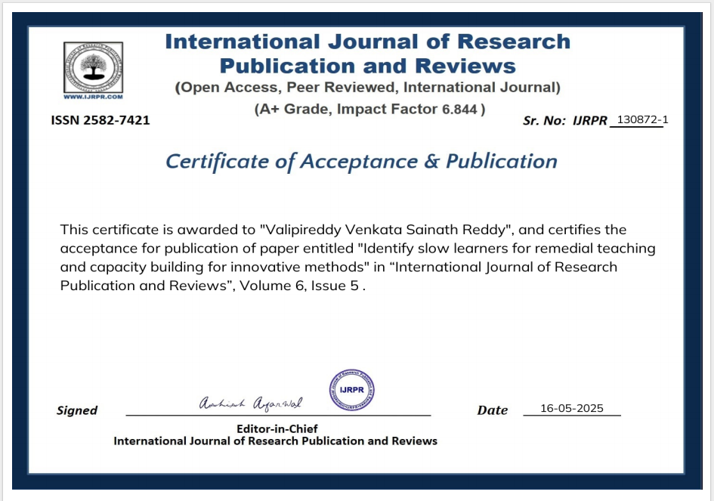
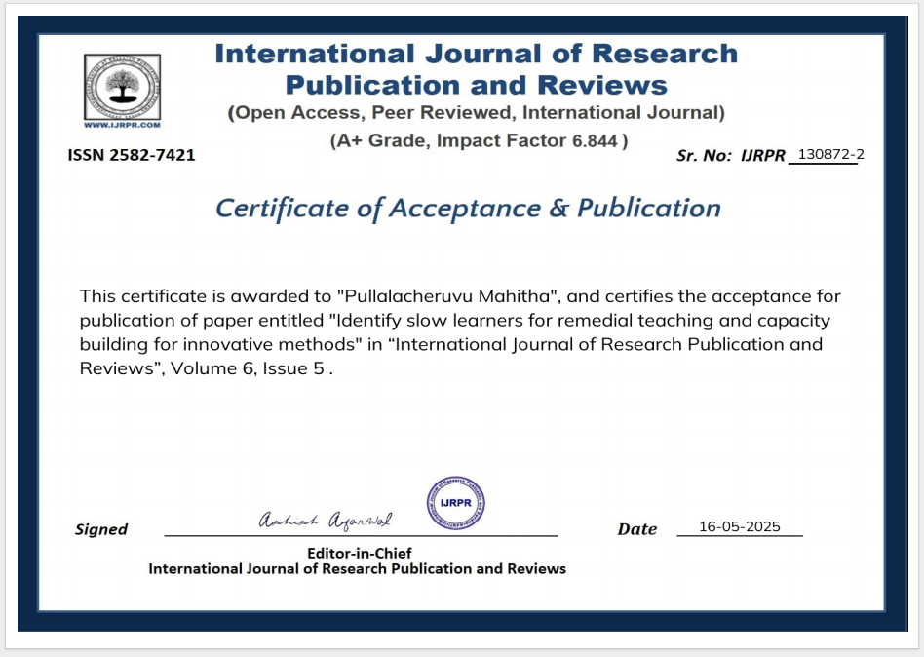
Publication Details

Slide 17
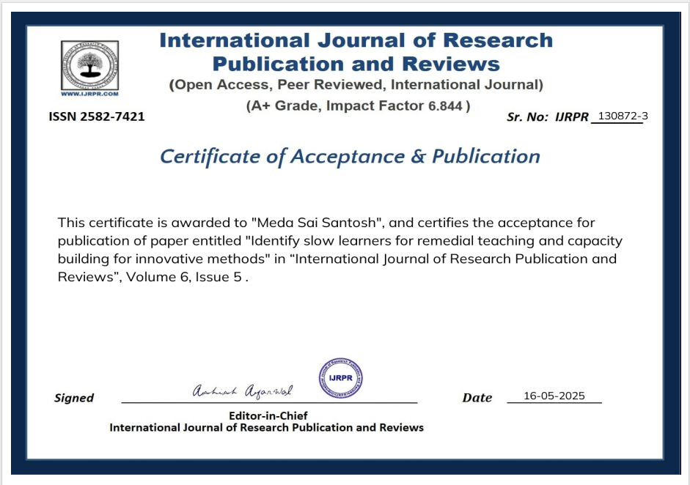
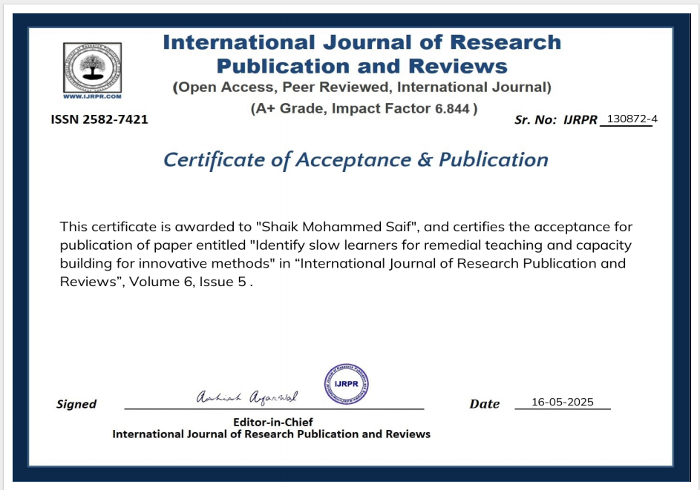
Publication Details

Slide 18
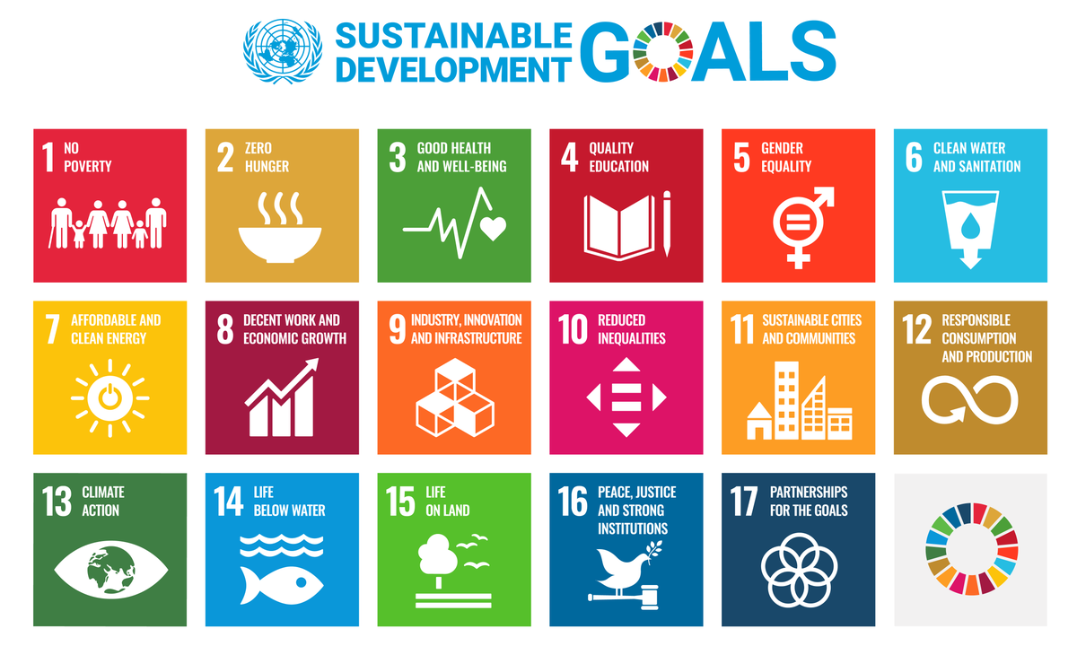
Project work mapping with SDG
SDG 4: Quality Education
Mentioned directly and aligned with targets 4.1, 4.5, and 4.c.
SDG 10: Reduced Inequalities
Referenced in relation to supporting marginalized learners.
SDG 3: Good Health and Well-being
Linked to early detection of learning or behavioral challenges.
SDG 17: Partnerships for the Goals
Cited in the context of involving parents, educators, and the community.

Slide 19
Fhgjkl;
Thank You

